Slide 1
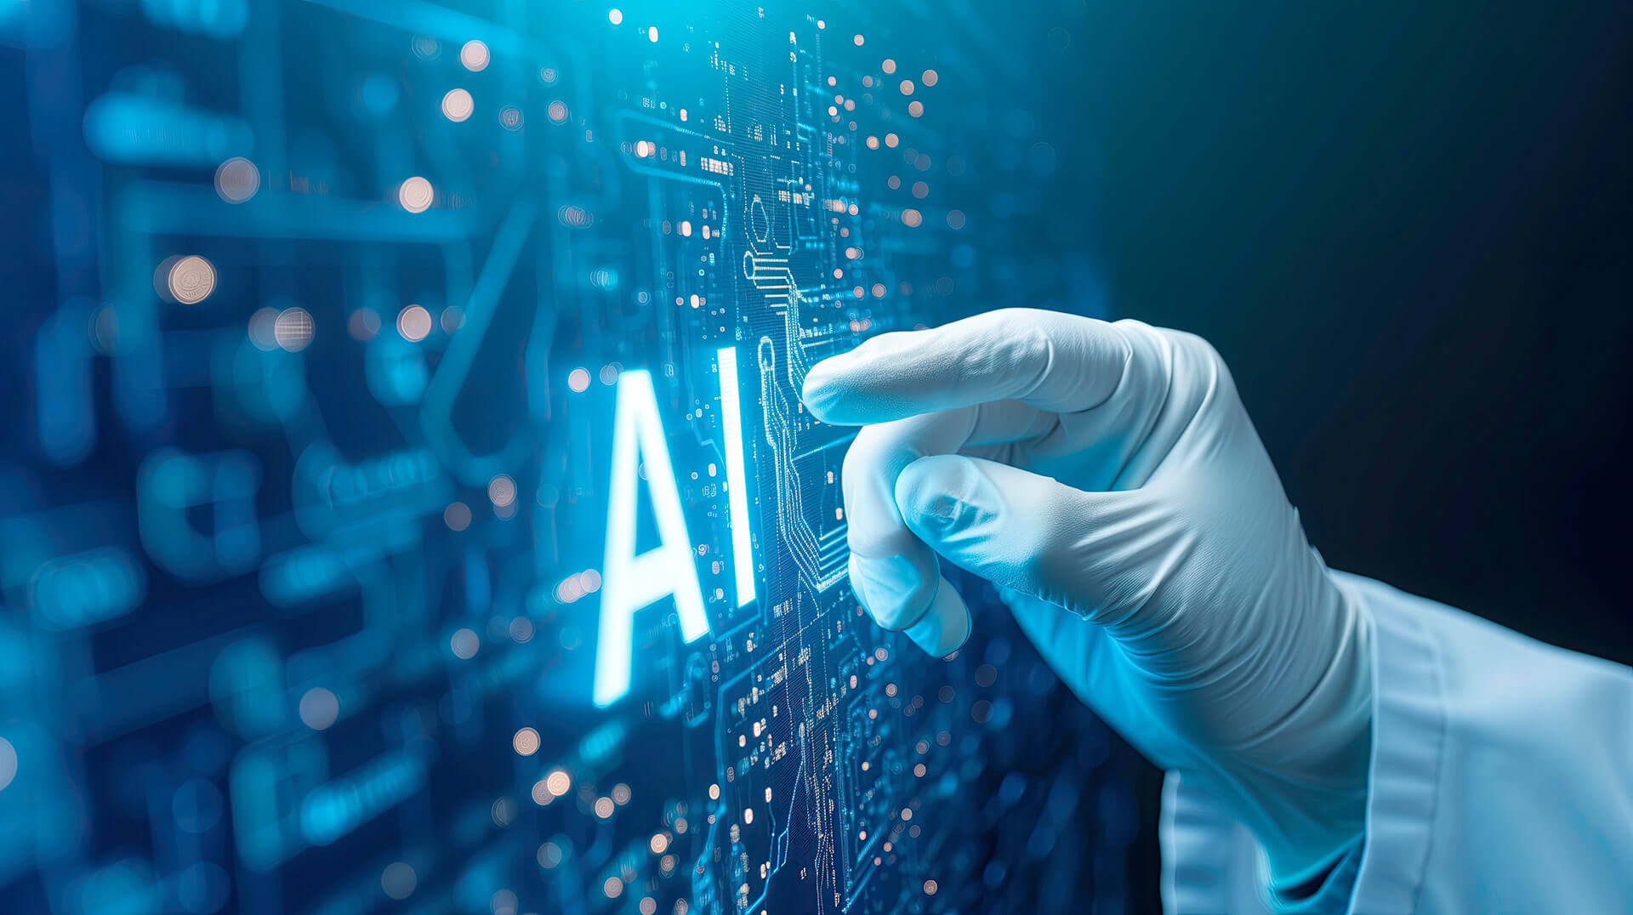

Slide 2
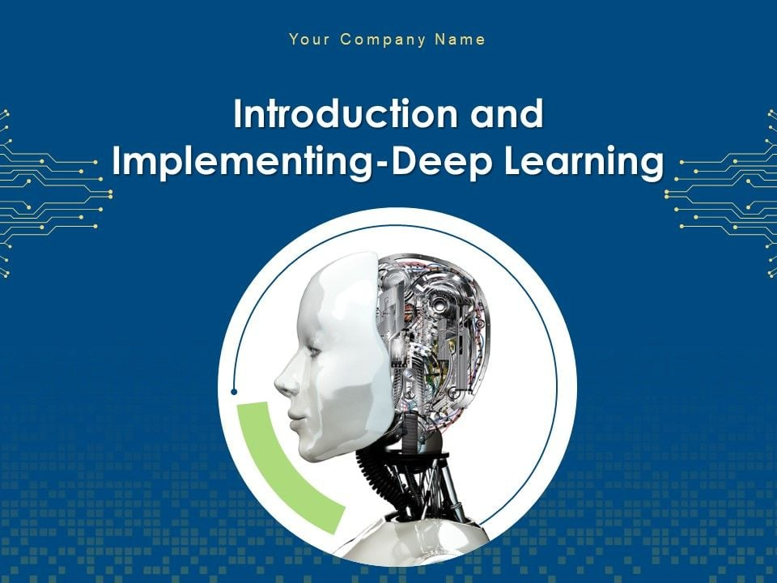

Slide 3
Introduction to DL
Introduction to Deep Learning
Perceptron Model
Introduction to Tensorflow and Keras
Introduction to Types of Neural Networks
https://www.geeksforgeeks.org/deep-learning-interview-questions/?ref=shm
https://www.geeksforgeeks.org/ai-ml-ds-projects/?ref=lbp
https://www.geeksforgeeks.org/deep-learning-tutorial/

Slide 4
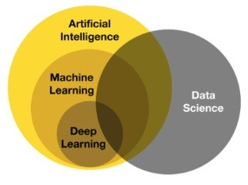
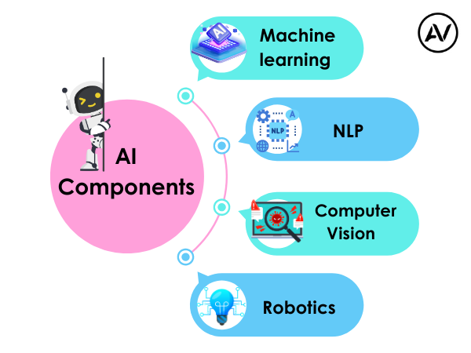
https://ellow.io/components-of-ai/

Slide 5
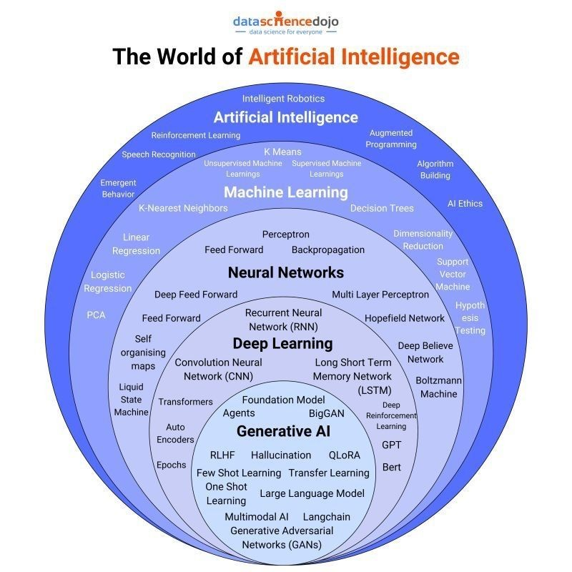
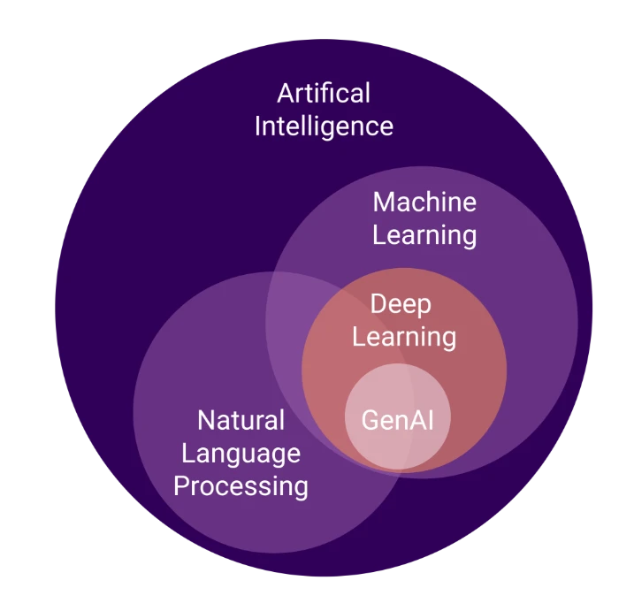
Algorithms and models

Slide 6
Artificial Intelligence (AI) refers to the simulation of human intelligence in machines that are designed to think, learn, and make decisions. AI encompasses a wide range of technologies, including rule-based systems, expert systems, and machine learning algorithms.
Key Features of AI:
Automation of tasks that require human intelligence.
Ability to learn from data and improve over time.
Applications across various domains, including healthcare, finance, and robotics.

Slide 7
AI vs ML vs DL
Artificial Intelligence (AI):
  The broadest concept, referring to machines that can perform cognitive functions similar to humans.
  Encompasses ML, DL, and rule-based systems.
  Examples: Virtual assistants, autonomous vehicles, and recommendation systems.
Machine Learning (ML):
  A subset of AI that enables machines to learn patterns from data without explicit programming.
  Uses statistical models and algorithms like decision trees, regression, and clustering.
  Examples: Fraud detection, predictive analytics, and spam filters.
Deep Learning (DL):
  A specialized subset of ML that relies on deep neural networks.
  Requires large datasets and computational power.
  Examples: Image recognition, natural language processing, and speech recognition.
Applications of AI
AI has transformed multiple industries by enabling automation and improving decision-making. Some major applications include:
Healthcare: Disease diagnosis, personalized medicine, robotic surgeries.
Finance: Fraud detection, algorithmic trading, risk assessment.
Retail: Recommendation systems, demand forecasting, customer sentiment analysis.
Autonomous Systems: Self-driving cars, drones, robotics.
Natural Language Processing: Chatbots, virtual assistants, language translation.

Slide 8
Conventional AI vs Generative AI (GenAI)
Conventional AI:
  Focuses on classification, prediction, and rule-based decision-making.
  Uses structured datasets for training.
  Examples: Spam filters, customer service chatbots, recommendation engines.
Generative AI (GenAI):
  A type of AI that creates new content, such as text, images, and music.
  Uses models like GANs (Generative Adversarial Networks) and transformers (e.g., GPT, DALL-E).
  Examples: AI-generated art, chat-based content generation, and text-to-image synthesis.
Future of AI
The future of AI is expected to bring significant advancements and challenges:
AI-Augmented Creativity: More sophisticated generative models for content creation.
Explainable AI (XAI): Enhancing transparency and trust in AI decision-making.
Ethical AI Development: Addressing biases, privacy concerns, and responsible AI use.
AI in Edge Computing: Deployment of AI models on edge devices for real-time processing.
Superintelligence and AGI: Theoretical advancements toward artificial general intelligence (AGI) with human-like reasoning capabilities.
AI continues to evolve, driving innovation and transforming industries worldwide.

Slide 9
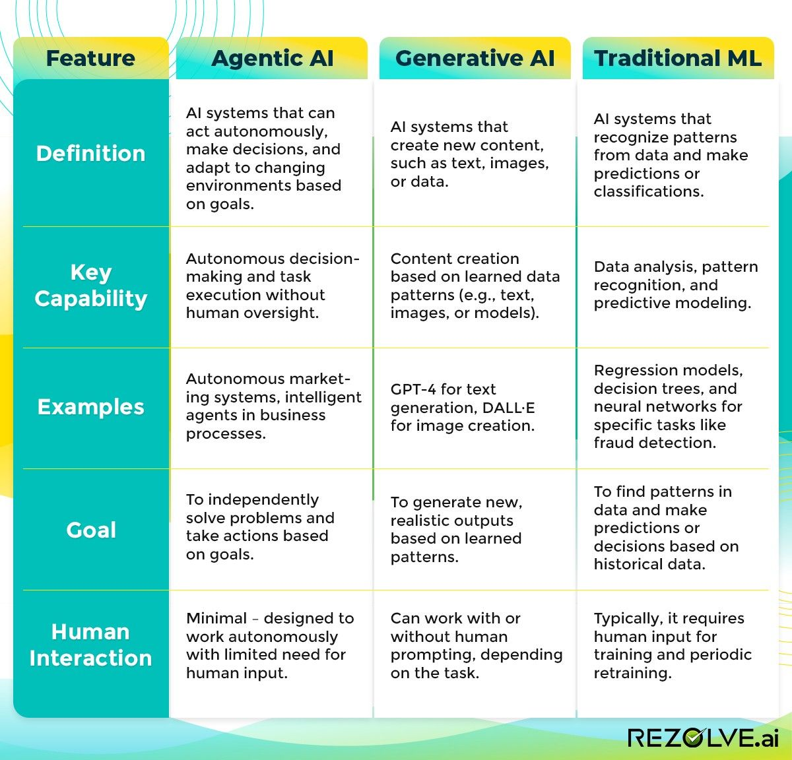

Slide 10
Key components of a Deep Learning:
1. Fundamentals of Neural Networks:
  Introduction to Artificial Neural Networks (ANNs)
  Perceptron model
  Activation functions (sigmoid, ReLU, tanh)
  Backpropagation algorithm
  Gradient descent optimization
2. Deep Learning Architectures:
  Multi-Layer Perceptron (MLP)
  Convolutional Neural Networks (CNNs)
  Recurrent Neural Networks (RNNs)
  Long Short-Term Memory (LSTM)
  Generative Adversarial Networks (GANs)
  Autoencoders
3. Advanced Optimization Techniques:
Momentum, RMSprop, Adam optimizer, and Learning rate scheduling.
4. Practical Implementation with Libraries:
TensorFlow, PyTorch, Keras, Data preprocessing and augmentation, and Model training and evaluation metrics.

Slide 11
5. Applications of Deep Learning:
  Computer Vision
    Image classification
    Object detection
    Image segmentation
  Natural Language Processing (NLP)
    Text classification
    Sentiment analysis
    Machine translation
  Speech Recognition
  Time Series Analysis
6. Ethical Considerations:
Bias in data and models, Privacy concerns, Explainability and interpretability, and Responsible AI practices.
Important Points to Consider:
Prerequisites:
A solid understanding of linear algebra, calculus, probability, and programming skills (usually Python) are required to fully grasp deep learning concepts.
Hands-on Projects:
Implementing various deep learning models on real-world datasets is crucial for gaining practical experience.
Stay Updated:
Deep learning is rapidly evolving, so continuous learning about new research and techniques is important.

Slide 12
Introduction to Deep Learning
Deep Learning (DL) is a subset of Machine Learning that utilizes artificial neural networks with multiple layers to learn complex patterns in data. It enables high-level feature extraction from raw data and is the foundation for many modern
AI applications.
Key Aspects of Deep Learning:
Multi-layered neural networks (deep networks) that extract hierarchical features.
Requires large datasets and significant computational power (e.g., GPUs, TPUs).
Performs exceptionally well in tasks like image recognition, natural language processing, and speech synthesis.

Slide 13
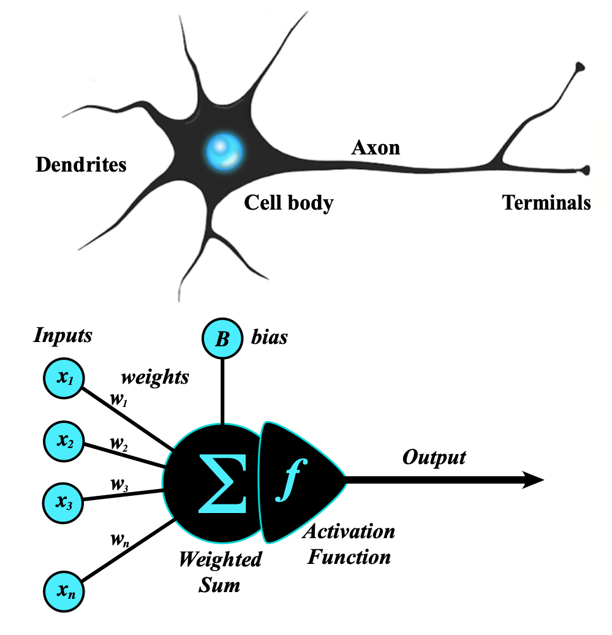
Artificial Neural Network
An artificial neural network (ANN) is a computational network (a system of nodes and the interconnection between nodes) inspired by biological neural networks, which are the complex networks of neurons in human brains (see Figure).
The nodes created in the ANN are supposedly programmed to behave like actual neurons, and hence they are artificial neurons.
https://medium.com/towards-data-science/what-the-hell-is-perceptron-626217814f53
https://s.mriquestions.com/what-is-a-neural-network.html
https://www.geeksforgeeks.org/neural-networks-a-beginners-guide/

Slide 14
Types of Neural Networks
Deep learning includes various types of neural networks optimized for specific tasks:
Perceptron (Single Neuron )
Multi Layer Perceptron (Multiple Neuron)
ANN
Feedforward Neural Networks (FNN):
  Basic architecture where information moves in one direction.
  Used in classification and regression tasks.
Convolutional Neural Networks (CNN):
  Specialized for image processing tasks.
  Uses convolutional layers to detect spatial features.
Recurrent Neural Networks (RNN):
  Designed for sequential data like time series and speech.
  Uses loops and memory to retain information from previous inputs.
Long Short-Term Memory (LSTM):
  A type of RNN that solves the vanishing gradient problem.
  Used in text generation, language modeling, and speech recognition.
Backword Propagations
https://wGenerative Adversarial Networks (GANs):
  Consist of a generator and a discriminator that compete to generate realistic data.
  Used in AI-generated art, deepfake videos, and data augmentation.
ww.geeksforgeeks.org/neural-networks-a-beginners-guide/

Slide 15
Perceptron Model
The perceptron is the simplest form of an artificial neural network and serves as the building block of more advanced models.
Components of a Perceptron:
  Inputs: Feature values from the dataset.
  Weights: Assigned to each input to signify importance.
  Summation Function: Computes the weighted sum of inputs.
  Activation Function: Applies a threshold to determine output.
The Perceptron was invented in 1957 by Frank Rosenblatt at the Cornell Aeronautics Laboratory. Based on the first concepts of artificial neurons, he proposed the “Perceptron learning rule“.

Slide 16
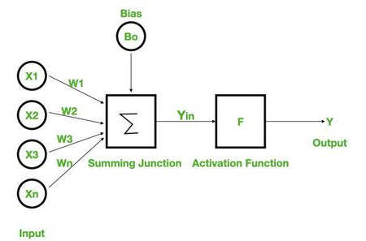
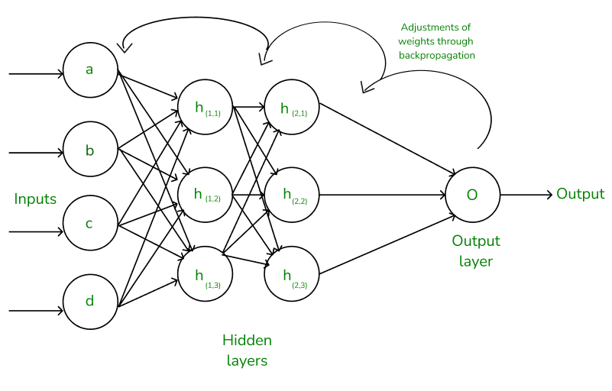
Types of Perceptron Models:
  Single-layer perceptron: Can only solve linearly separable problems.
  Multi-layer perceptron (MLP): Can solve non-linear problems using multiple layers.
Neural Networks Architecture:
the basic elements of the network's architecture.
made of three core layers:
Input layer
Hidden layers
Output layer

Slide 17
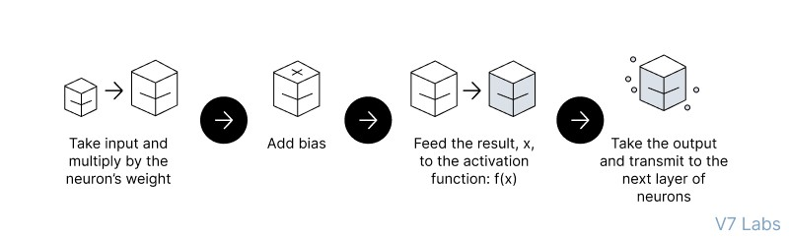
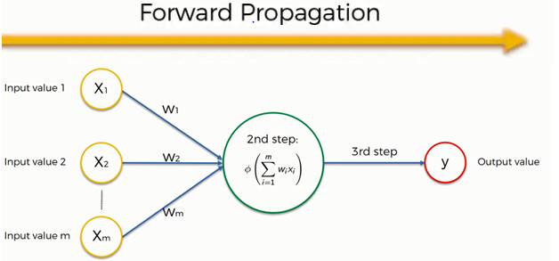
Feedforward Neural Networks (FNN):
the flow of information occurs in the forward direction. The input is used to calculate some intermediate function in the hidden layer, which is then used to calculate an output.
Working of Neural Networks
Forward Propagation
  input
  calculation -->then apply activation func
  output
  Implement the FNN
  https://colab.research.google.com/drive/1z_nL3RcvR1x4uIR88VWEj8Zdr7mYEcQK#scrollTo=keCSdzvOrRmx

Slide 18
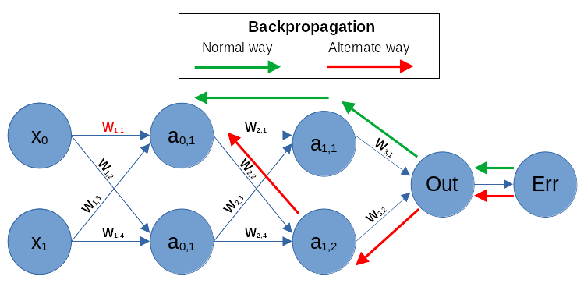
2. Backpropagation
- the weights of the network connections are repeatedly adjusted to minimize the difference between the actual output vector of the net and the desired output vector.
Backpropagation
  Loss Calculation
  Gradient Calculation
  Weight Update
https://www.guru99.com/backpropogation-neural-network.html
Feedforward vs. Backpropagation
https://www.geeksforgeeks.org/backpropagation-in-neural-network/

Slide 19
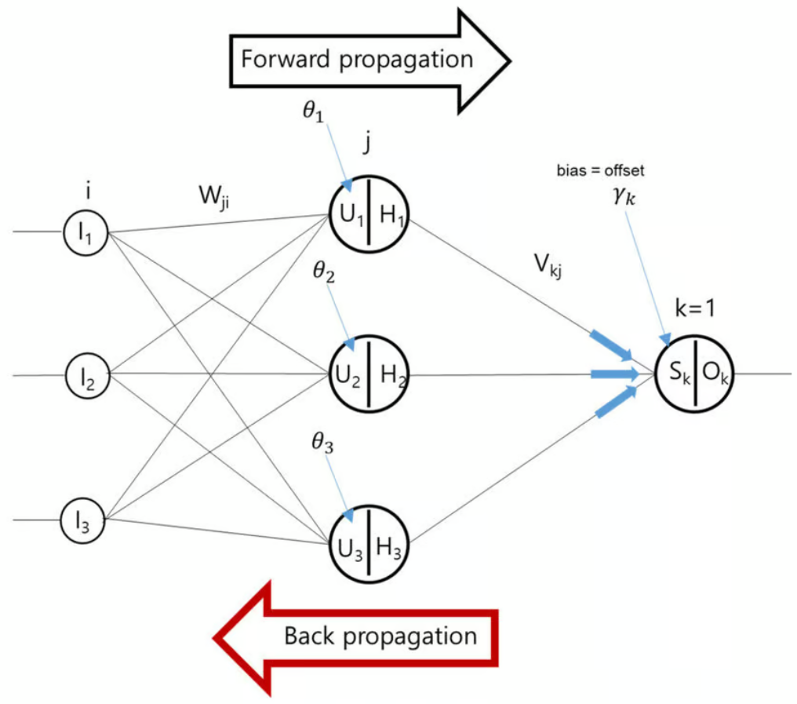
Terms Neural Networks Architecture:
features
weights
bias
USE IN ANN
  Perceptron
  Hidden layers
  neurons
  Weights and bias
for non linearity in neural network
  activation functions
for error calculations/loss functions/cost functions
  mse,mae, logloss
for optimizations
  gradient descent/ optimzer
4. Evaluation Matrix
  classification
  regression

Slide 20
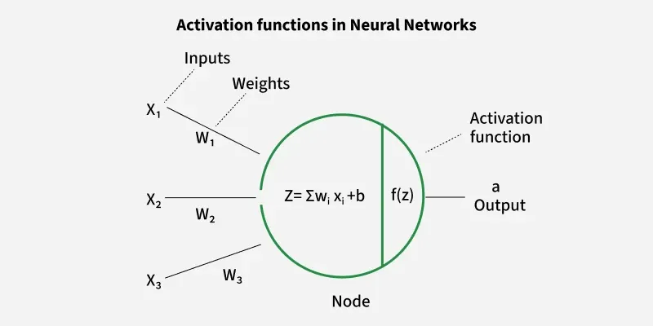

Slide 21
What we learn
Introduction to AI
AI vs ML vs DL
Applications of AI
Conventional AI vs GenAI
Future of AI
Introduction to DL
Introduction to Deep Learning
Perceptron Model
Introduction to Tensorflow and Keras
Introduction to Types of Neural Networks
Artificial Neural Network Deep Dive
Activation Functions in NN
Loss Functions
Optimization Technique
Regularization Techniques
CallBacks
Computer Vision
Object Detection
Region Proposal Techniques
Semantic Segmentation
Computer Vision with OpenCV
Working with images
Working with Videos
OCR
Media Pipe - FaceMesh, Pose Detection
Convolution Neural Network
Introduction to CNN
Architecture of CNN - Kernel / Filter, Stride, Padding, Activation Function Max Pooling and Avg Pooling
Natural Language Processing
Introduction to NLP
Text Preprocessing
Text Vecorization and Classification
Embedding Layer in Natural Language Processing
Sentiment Analysis
Sequence Model
Machine Translation
Introduction to LLM
Recurrent Neural Network
Introduction to RNN
LSTM
Bi-directional LSTM
GRU

Slide 22
RASA Chatbot
What is RASA
RASA Installation
RASA Initialization
RASA Configuration and File System
Intents, Entity,Response and Story
Actions
Stock Price Prediction using Sequence Model
Introduction to Sequence Models RNN, LSTM
Preparing Time Series Data for LSTM
Forecasting using LSTM
Future Forecast
Assignment
GEN AI
LLM
AGENTIC AI
CLOUD AI
Introduction to Time Series Analysis
What is Sequential Data & Time Series
Functional Relationship
Components of Time Series
Mathemetical Representation of Time Series
ETS Decompositon
Classification of Time Series
Defference between ACF & PACF
Assignment
Weather Forecasting using ARIMA Model
Introduction to AR and MA model
Stationarity & Differencing
SariMax of Seasonal Data
Identifying order AR(p), I(d), MA(q)
Implementation of ARIMA
Assignment

Slide 23
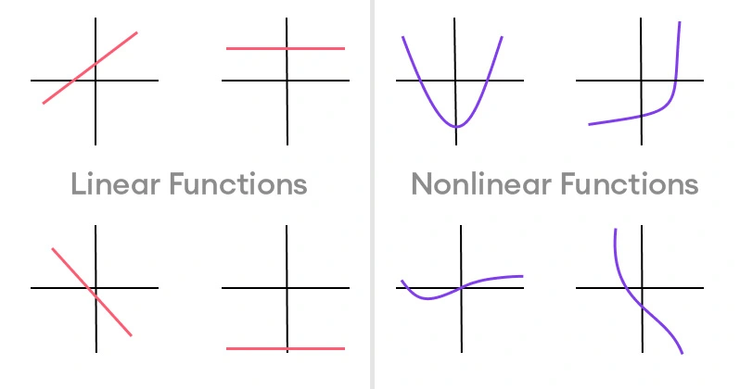
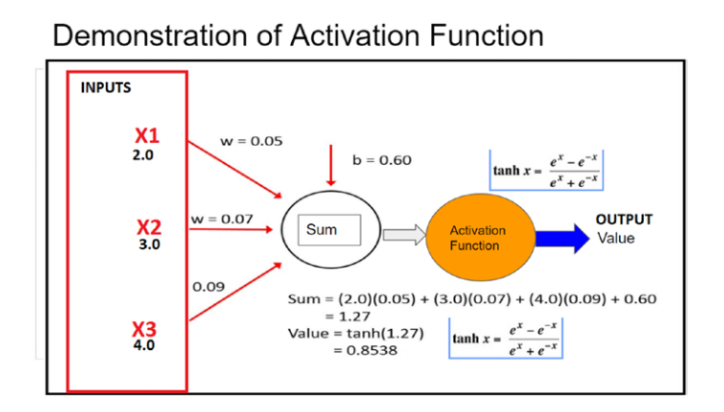
  Next Topic Activation functions
https://www.superannotate.com/blog/activation-functions-in-neural-networks

Slide 24
